Slide 1

CAPSTONE PROJECT
QUEUE BASED HOSPITAL APPOINTMENT BOOKING AND PATIENT SCHEDULING MANAGEMENT SYSTEM
CSA0315 – DATA STRUCTURES
UNDER THE SUPERVISION OF:
DR. T. RAJESH KUMAR
PRESENTED BY:
Moniga V (192521184)
Dhivyabharathi (192521233)
Sugiritha M (192471020)

Slide 2
ABSTRACT
The system manages hospital appointments using a Queue data structure.
It follows the FIFO (First In, First Out) principle.
Patients can register their details and book appointments.
Patients are added to the waiting queue according to their arrival order.
Available doctors are assigned to patients systematically.
Appointment statuses such as Waiting, Assigned, Completed, and Cancelled are maintained.
The system reduces manual work and appointment confusion.
It improves the overall flow and organization of patients in the hospital.

Slide 3
OBJECTIVE
• To develop an efficient system for registering patients and managing appointment information.
• To implement the FIFO Queue principle for scheduling patients according to their arrival order.
• To provide an organized mechanism for assigning waiting patients to available doctors.
• To maintain appointment statuses such as Waiting, Assigned, Completed, and Cancelled • To generate useful appointment information and basic statistics for hospital management.

Slide 4
INTRODUCTION
• The Hospital Appointment Booking System is designed to manage patient appointments in an organized and efficient manner using the Queue data structure..
• The system allows patients to register their details, book appointments, and enter a waiting queue based on their order of arrival.
• Patients are assigned to available doctors systematically, ensuring that patients are served according to their position in the queue.
• The system reduces manual work, minimizes appointment confusion, and improves the overall flow of patients within the hospital.
• The project demonstrates how the FIFO (First In, First Out) principle can be applied to a real-world healthcare management problem.

Slide 5
PROBLEM STATEMENT
Managing a large number of patients manually can result in long waiting times, scheduling conflicts, and difficulty maintaining appointment order.
Hospital staff may find it difficult to monitor waiting patients and available doctors simultaneously.
Patients may experience confusion when appointments are not handled according to their arrival order.
Manual appointment records make it difficult to track completed and pending appointments.
Therefore, a queue-based system is required to provide systematic, fair, and efficient patient scheduling.

Slide 6
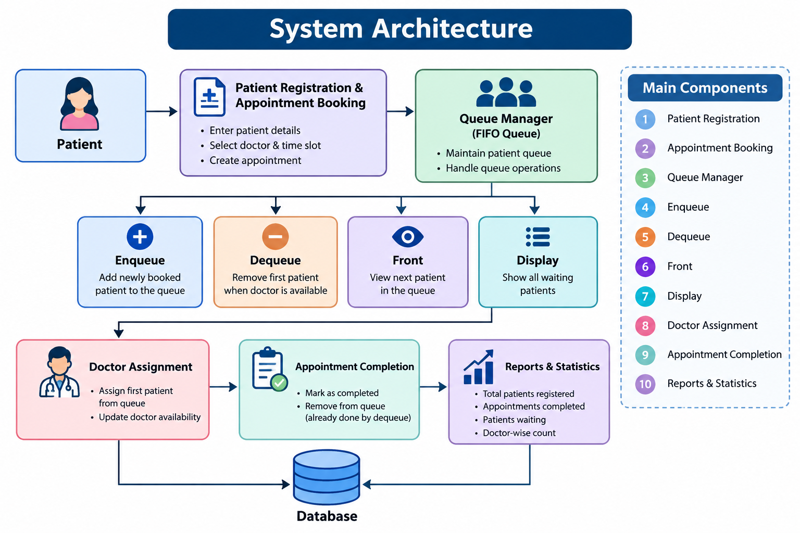

Slide 7
ALGORITHM
StartRegister the patient details.
Book an appointment and generate a queue number.
Add the patient to the rear of the queue (Enqueue).
Check whether a doctor is available.
If a doctor is available, select the patient at the front of the queue.
Assign the patient to the available doctor.
Remove the patient from the queue (Dequeue).
Update the appointment status.
After consultation, mark the appointment as Completed.
Maintain appointment records and generate reports.Stop

Slide 8
PSEUDOCODE
START
Create an empty Queue
1. Register Patient
Read patient name and details
Store patient information
2. Book Appointment
Add patient to the rear of the Queue
3. Process Appointment
IF Queue is not empty THEN
Remove patient from the front
Assign available doctor
Mark appointment as "Assigned"
ELSE
Display "No patients in queue"
END IF
4. Complete Appointment
Update appointment status to "Completed"
Record appointment details
5. Display Queue
Show all waiting patients in FIFO order
STOP

Slide 9
MODULE 1 – PATIENT REGISTRATION AND APPOINTMENT BOOKING
The module collects essential patient information such as Patient ID, Name, Age, Gender, Contact Number, and Appointment Details.
Patients can select an available doctor or department according to their healthcare requirements.
After booking, the system generates a unique appointment or queue number for the patient
The registered patient is added to the waiting queue in the appropriate order
This module provides the basic patient and appointment information required for further processing.
MAIN FUNCTIONS :
-> Patient Registration
-> Patient Information Entry
-> Doctor Selection
-> Appointment Booking
-> Queue Number Generation
->Appointment Confirmation

Slide 10
MODULE 2 – QUEUE-BASED PATIENT SCHEDULING AND DOCTOR ASSIGNMENT
• This module manages patients using the FIFO (First In, First Out) principle.
Monitor temperature, pressure, current, and vibration.
• New patients are added to the rear of the queue using the Enqueue operation.
• When a doctor becomes available, the patient at the front of the queue is selected.
• The selected patient is assigned to the available doctor and their appointment status is updated.
• After assignment, the patient is removed from the queue so that the next waiting patient can be processed.
• Monitor temperature, pressure, current, and vibration.
MAIN FUNCTIONS
-> Add Patient to Queue
-> View Waiting Patients
-> Check Doctor Availability
-> Assign Patient to Doctor
-> Remove Patient from Queue
->Update Appointment Status

Slide 11
MODULE 3 – APPOINTMENT COMPLETION, REPORTING AND STATISTICS
• After consultation, the patient's appointment status is updated to Completed.
• The system maintains appointment records for future reference and reporting.
• Hospital staff can monitor waiting, assigned, completed, and cancelled appointments.
• The system can generate daily appointment summaries and doctor-wise appointment information.
• Basic statistics can help identify patient flow and doctor workload.
• Display dashboard with KPI cards and equipment overview.
MAIN FUNCTIONS
-> Complete Appointment
-> Update Patient Status
-> Maintain Appointment History
-> Generate Reports
-> Calculate Statistics
-> Display Daily Summary

Slide 12
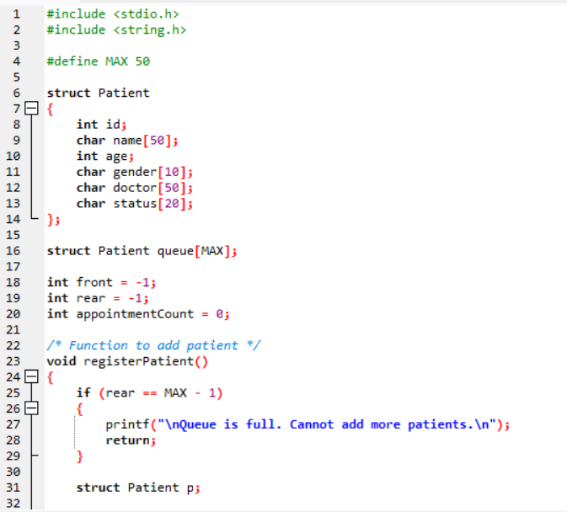
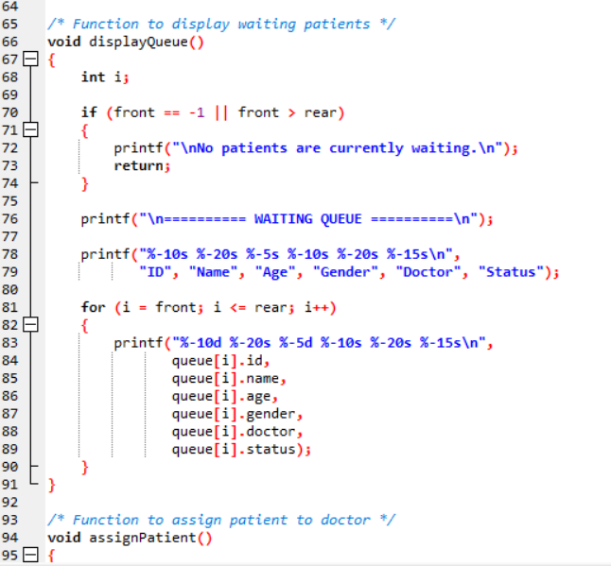
INPUT AND CODE SNIPPETS

Slide 13
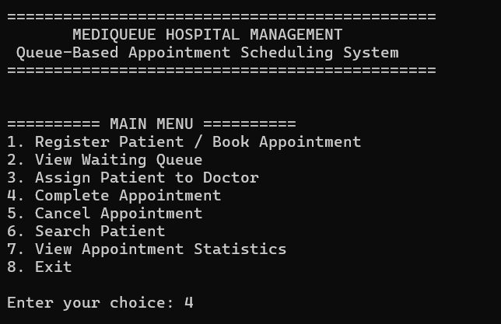
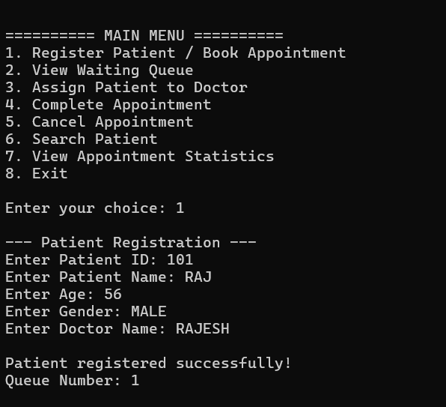
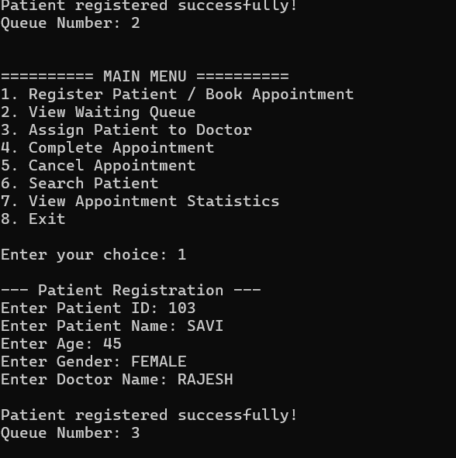
OUTPUT

Slide 14
RESULTS AND DISCUSSIONS
The system successfully manages patients using a Queue data structure.
Patients are processed according to the FIFO (First In, First Out) principle.
Patient registration and appointment booking are organized systematically.
The queue helps maintain the correct order of patients waiting for consultation.
Doctors can be assigned to patients based on queue order and availability.
Appointment status can be tracked as Waiting, Assigned, Completed, or Cancelled.
The system reduces confusion and manual effort in appointment management.
Overall, the project demonstrates how a Queue can be applied to a real-world hospital appointment system.

Slide 15
CONCLUSION
• The system provides an efficient method for hospital appointment management.
• It uses the Queue data structure based on the FIFO principle.
• Patients are served fairly in their order of arrival.
• Enqueue and Dequeue operations manage patient appointments effectively.
• Doctors can be assigned systematically based on queue order and availability.
• The system helps reduce waiting confusion and improve patient flow.
• Appointment completion and basic reports and statistics can be maintained.
• The project demonstrates a real-world application of Queue data structures.
• Overall, it provides a simple, organized, and reliable appointment scheduling solution.

Slide 16
FUTURE ENHANCEMENTS
• Online appointment booking can be added.
• Multiple doctors and departments can be handled using separate queues.
• Priority Queue can be introduced for emergency patients.
• Real-time queue status can show the patient's position and estimated waiting time.
• Patient history can be stored and accessed.
• SMS/notification system can inform patients about their appointment.
• Reports and statistics can be improved using graphs and charts.
• The system can later be connected to a hospital management system.

Slide 17
REFERENCES
Bailey, N. T. J. (1952). A study of queues and appointment systems in hospital out-patient departments, with special reference to waiting-times. Journal of the Royal Statistical Society: Series B (Methodological), 14(2), 185–199.
Green, L. V., & Savin, S. (2008). Reducing delays for medical appointments: A queueing approach. Operations Research, 56(6), 1526–1538.
De Vuyst, S., Bruneel, H., & Fiems, D. (2014). Computationally efficient evaluation of appointment schedules in health care. European Journal of Operational Research, 237(3), 1142–1154.
Ala, A., & Chen, F. (2022). Appointment scheduling problem in complexity systems of the healthcare services: A comprehensive review. Journal of Healthcare Engineering.
Safdar, K. A., Emrouznejad, A., & Dey, P. K. (2020). An optimized queue management system to improve patient flow in the absence of appointment system. International Journal of Health Care Quality Assurance.
Hassin, R., & Mendel, S. (2008). Scheduling arrivals to queues: A single-server model with no-shows. Management Science, 54(3), 565–572

Slide 18
THANK YOU

